Slide 1
Linuxbrew
Yet another packaging system
Thibaut Hourlier Genome annotation team
www.ebi.ac.uk

Slide 2
What is it?
Based on Homebrew, software manager for Mac OSX like MacPorts
Written in Ruby
LINUXBREW_HOME
Cellar, Kegs, Bottle, Formula
Best page ever
https://github.com/Homebrew/brew/blob/master/docs/Formula-Cookbook.md
Installed in Cellar then link to linuxbrew home

Slide 3
Who can install software
ENSEMBL_HOME_SOFTWARE
/nfs/sotware/ensembl/RH7
ENSEMBL_MOONSHINE_ARCHIVE
/nfs/software/ensembl/ENSEMBL_MOONSHINE_ARCHIVE
LINUXBREW_HOME
/nfs/software/ensembl/RHEL7/linuxbrew

Slide 4
How can I install my software
homebrew-ensembl
homebrew-moonshine
homebrew-web
homebrew-icc
homebrew-cask

Slide 5
How to install linuxbrew
export ENS=/nfs/production/panda/ensembl/thibaut
cd $ENS
mkdir linuxbrew
git clone https://github.com/Linuxbrew/brew.git linuxbrew
export PATH=$ENS/linuxbrew/bin:$PATH; export MANPATH=$ENS/linuxbrew/share/man:$MANPATH; export INFOPATH=$ENS/linuxbrew/share/info:$INFOPATH
brew install ensembl/ensembl/exonerate09

Slide 6
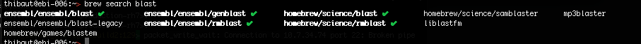
Few interesting commands
brew search blast
brew list blast
brew update
brew upgrade
brew cleanup

Slide 7
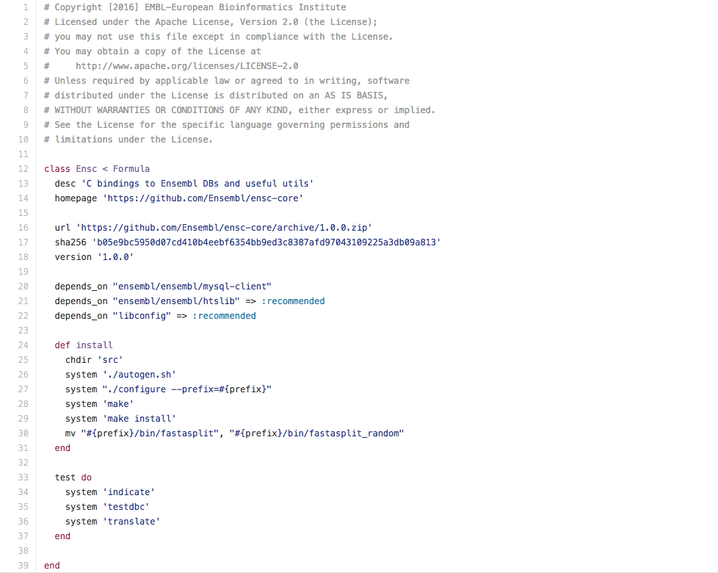
Creating a formula

Slide 8
Testing your formula
brew install ensc.rb –debug
brew install –i ensc.rb
brew uninstall ensembl/ensembl/ensc
brew unlink ensembl/ensembl/ensc

Slide 9
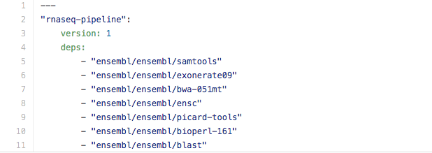
Creating a meta formula
./bin/create_cask --verbose --config my-name.yml --dir $PWD

Slide 10
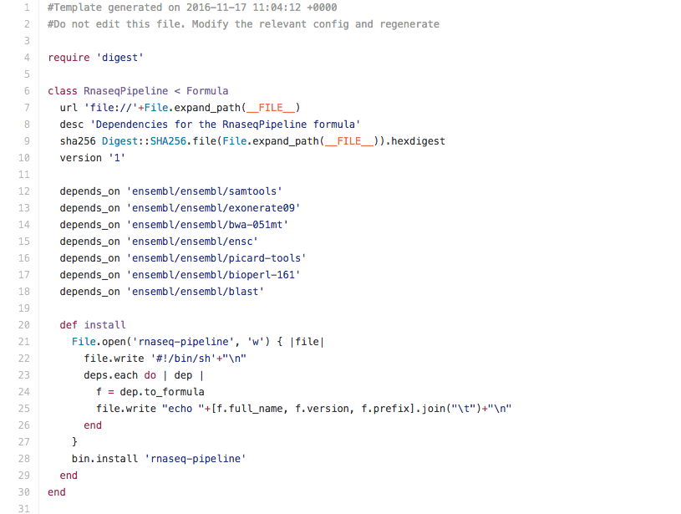
Creating a meta formula

Slide 11
Summary
Publicly available code in homebrew-ensembl
Private/licensed code in homebrew-moonshine
Create as many meta package as needed
for a pipeline
for your team
for a task

